Slide 1
Expense manager
Name: Mst.Sadia Afrin
Id:16201064
Name: Umme Salma lucky
Id:16201058

Slide 2
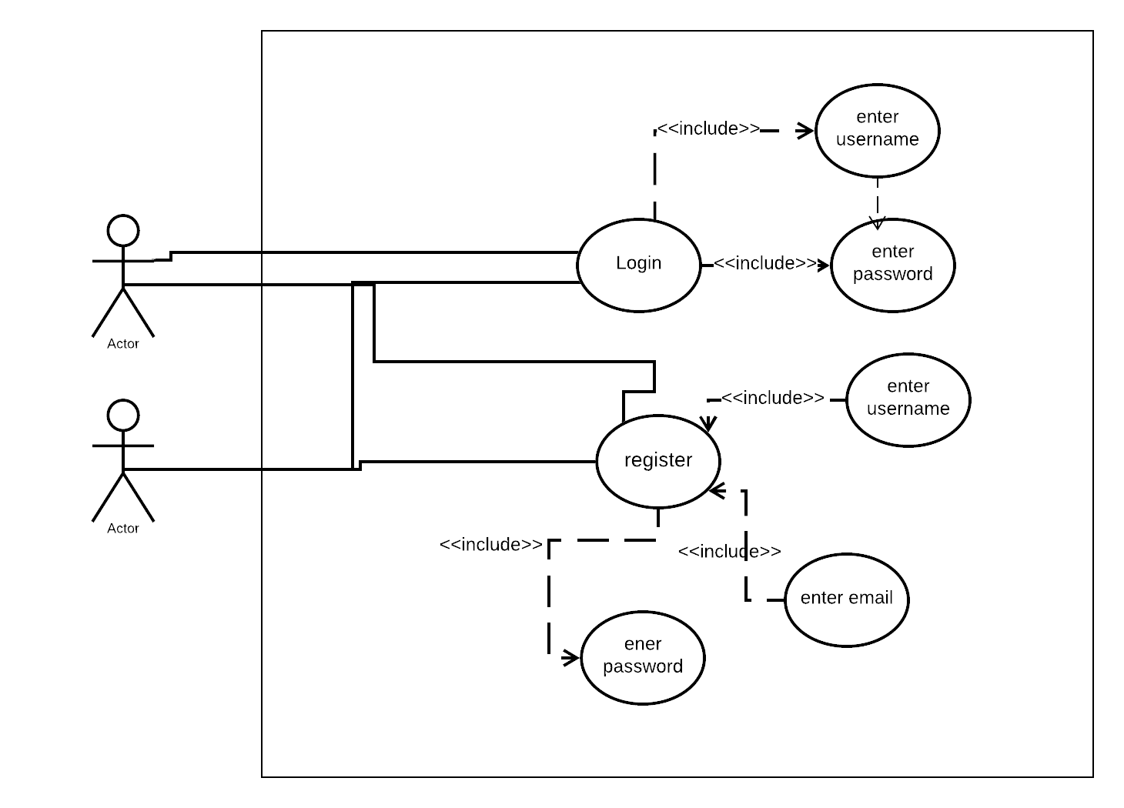
Use case diagram for login subsystem:
user
database

Slide 3
Use case narrative:
Name: login
Priority: High
Primary Actor: user
Secondary Actor: database
Precondition: application have been installed

Slide 4
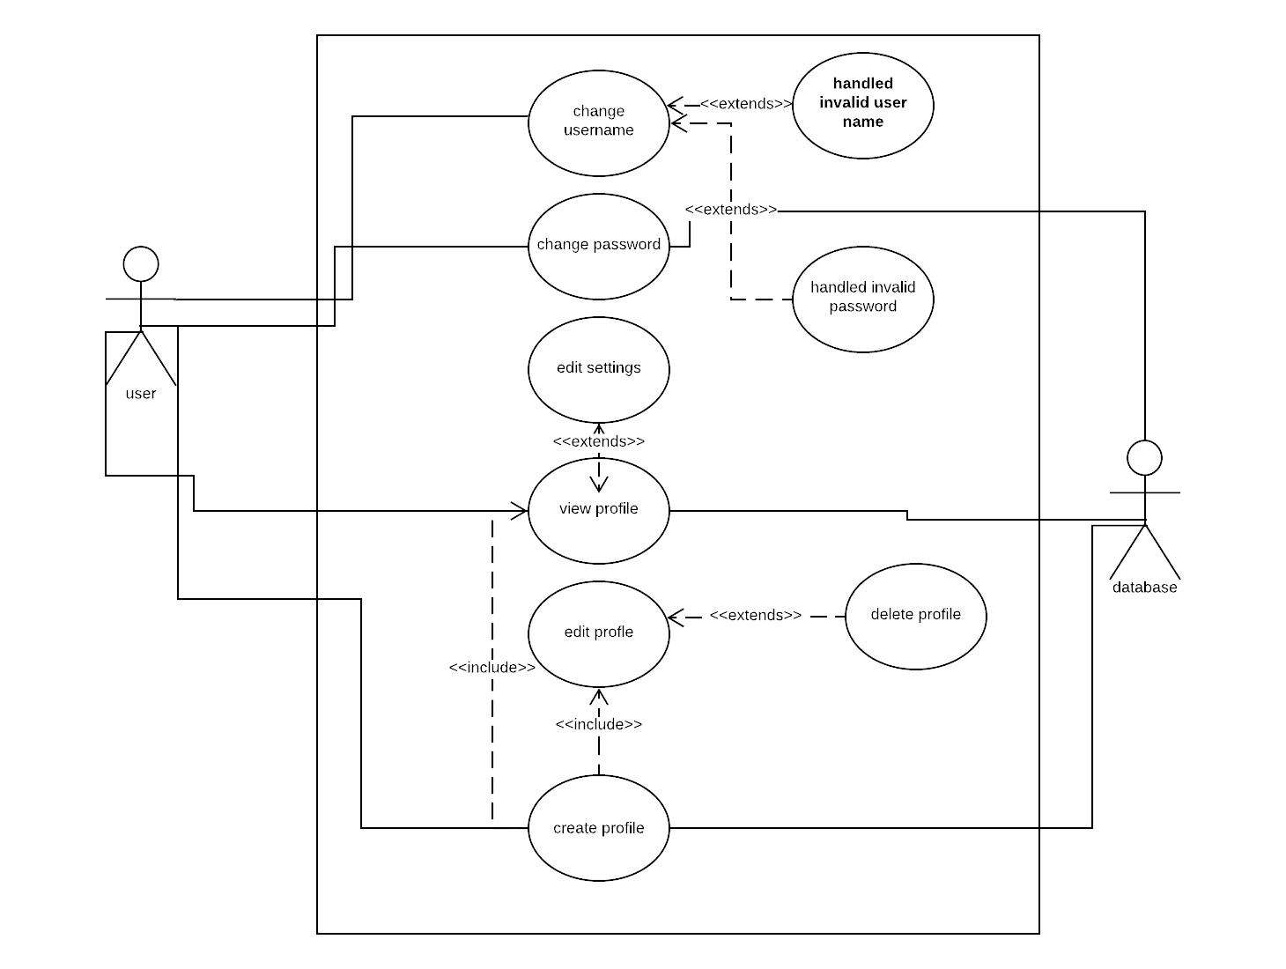
Use case diagram for profile management:

Slide 5
Use case narrative:
Name: profile management
Priority: High
Primary Actor: user
Precondition: User is Logged into the system
Post-Condition: User successfully updates his/her own details.
Trigger:User has registered into the System

Slide 6
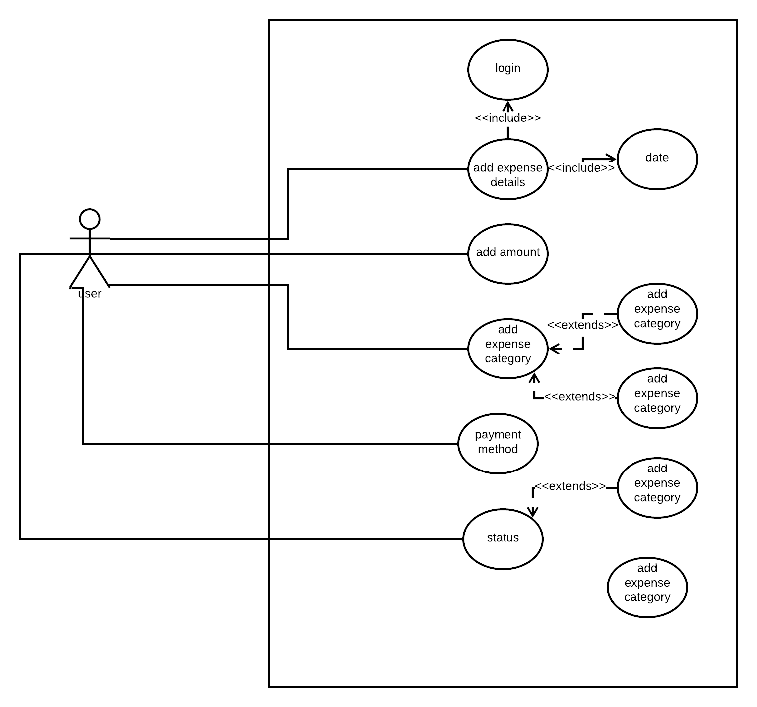
Use case diagram for add income details:
user
<<extends>>

Slide 7
Use case narrative:
Name: add income
Priority: High
Primary Actor: user
Precondition: User is Logged into the system
Post-Condition: User successfully add his/her income details.
Trigger: User has registered into the System

Slide 8
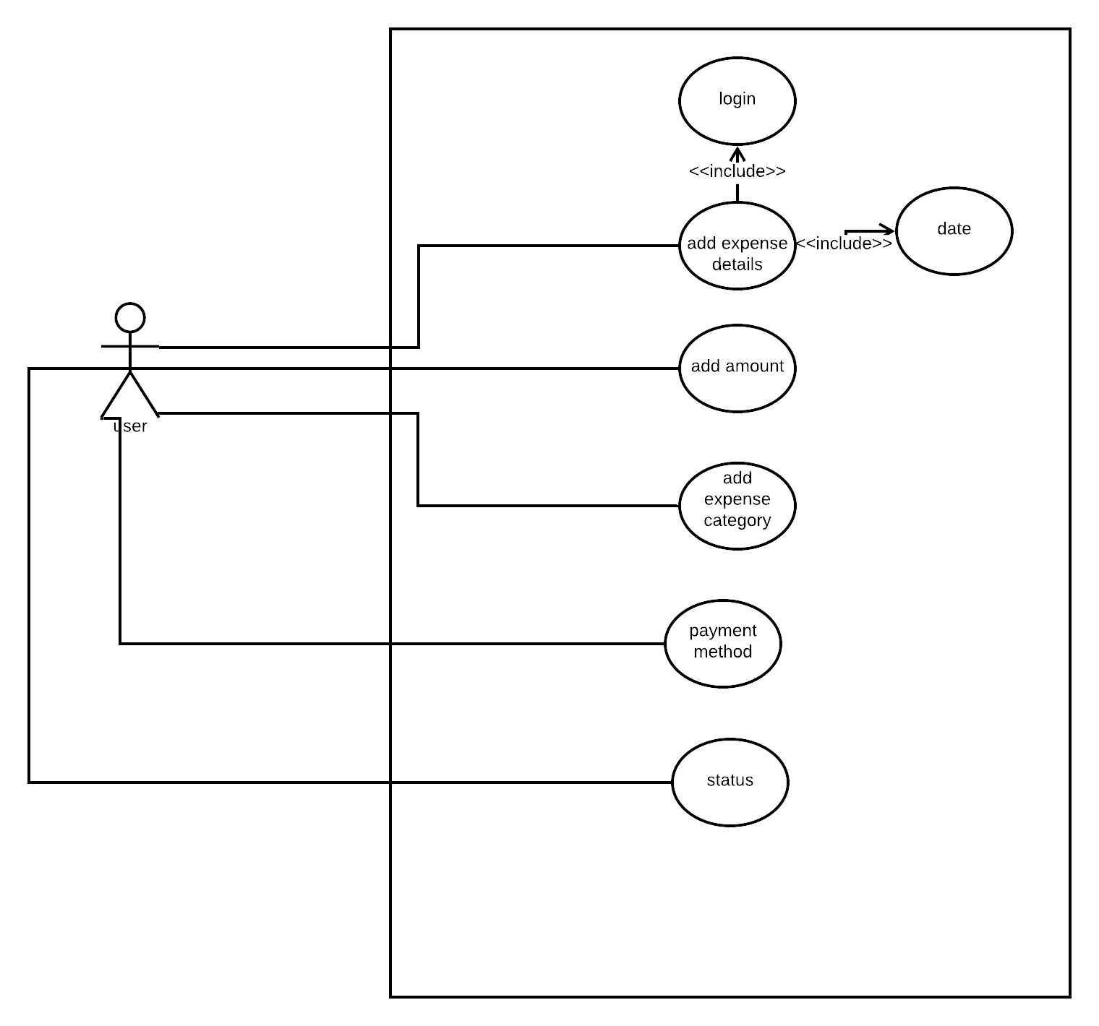
Use case diagram for adding expenses:

Slide 9
Use case narrative:
Name: add expense
Priority: High
Primary Actor: user
Precondition: User is Logged into the system
Post-Condition: User successfully add his/her expense details.
Trigger: User has registered into the System

Slide 10
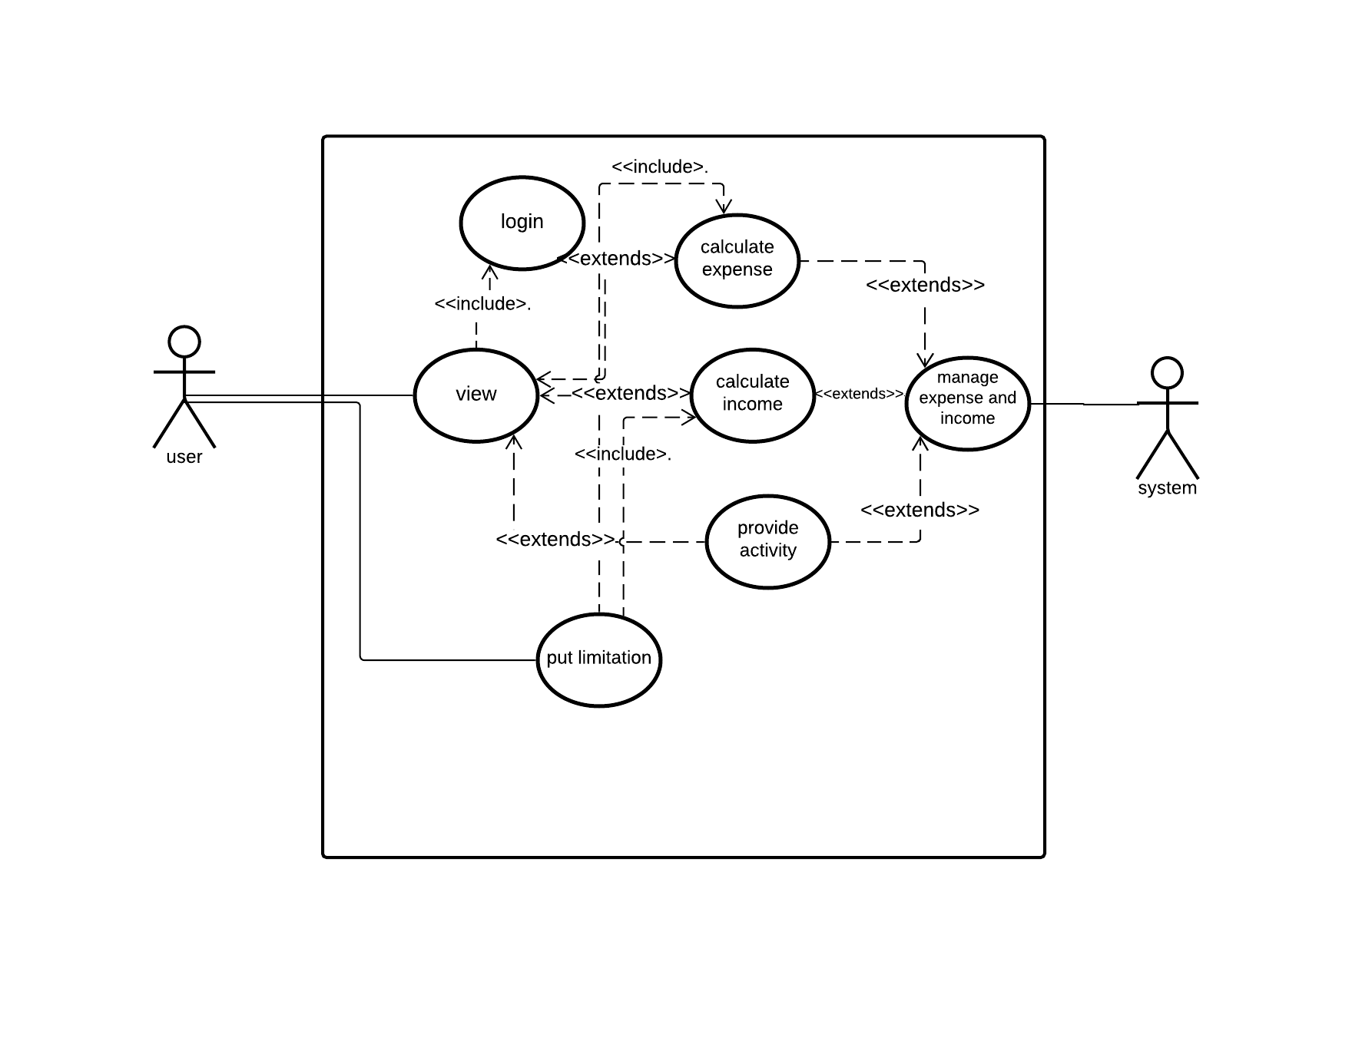
Use case diagram for i/E manager:

Slide 11
Use case narrative:
Name: I/E manage
Priority: High
Primary Actor: user
Precondition: User is Logged into the system
Post-Condition: User can save the records
Assumption: Users are using this application to manage their daily expenses.

Slide 12
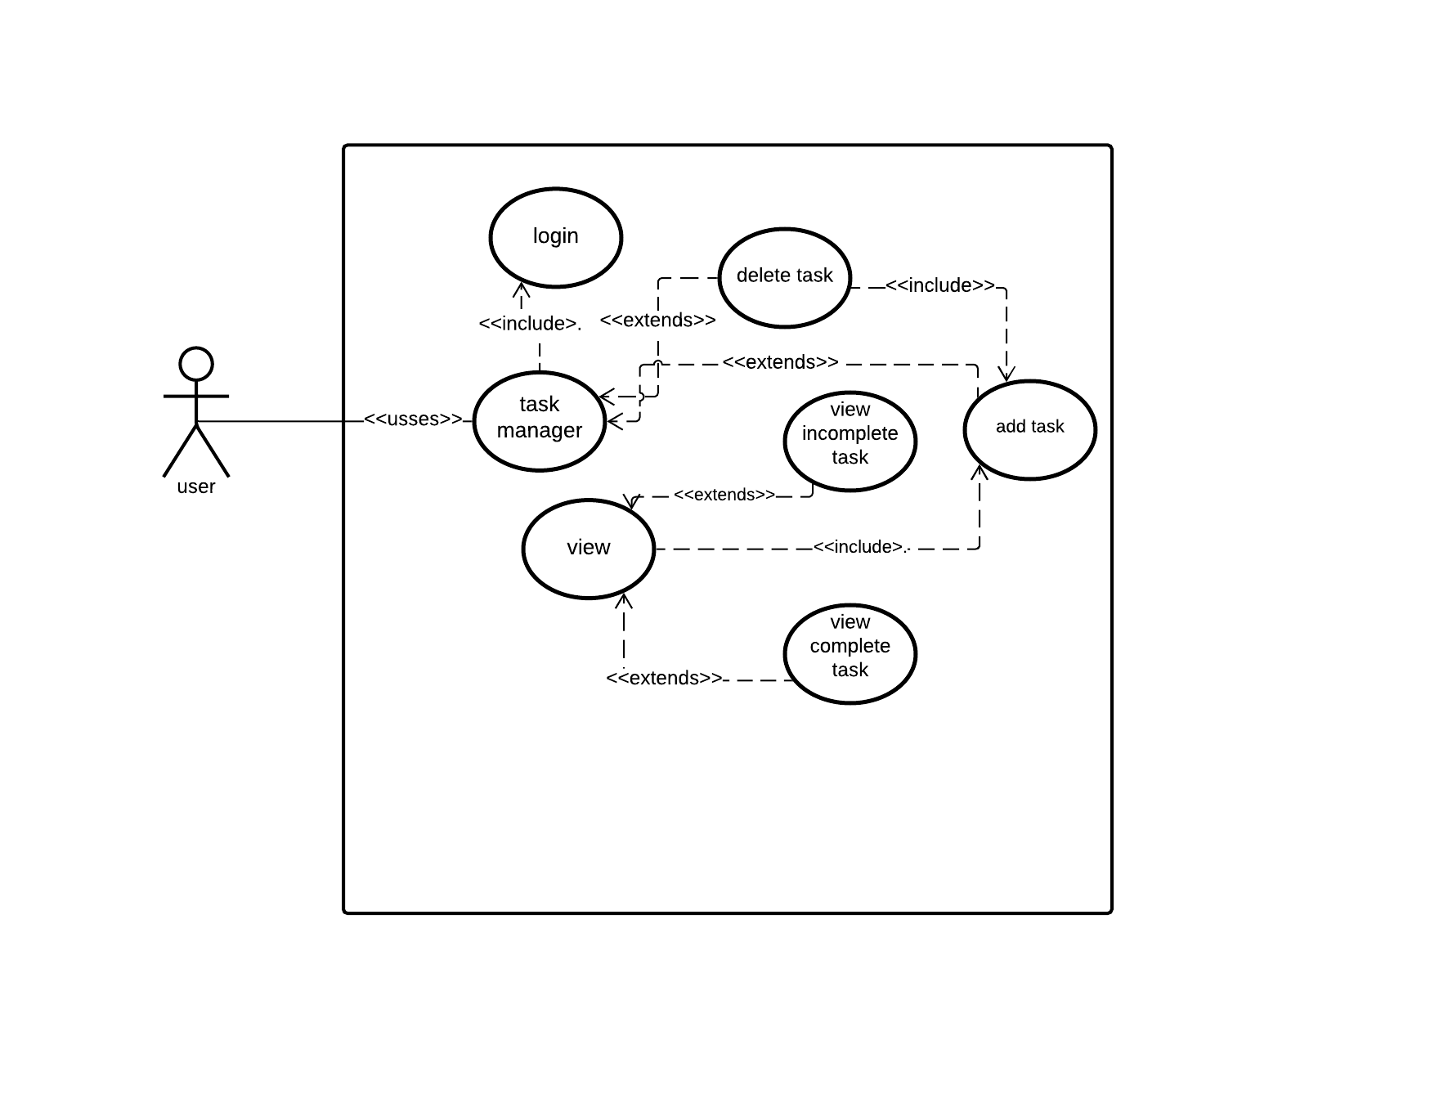
Use case diagram for task manager:

Slide 13
Use case narrative:
Name: task manager
Priority: High
Description: This is for view, create and delete the task.
Primary Actor: user
Precondition: User has added the task
Post-Condition: User can create ,delete the records

Slide 14
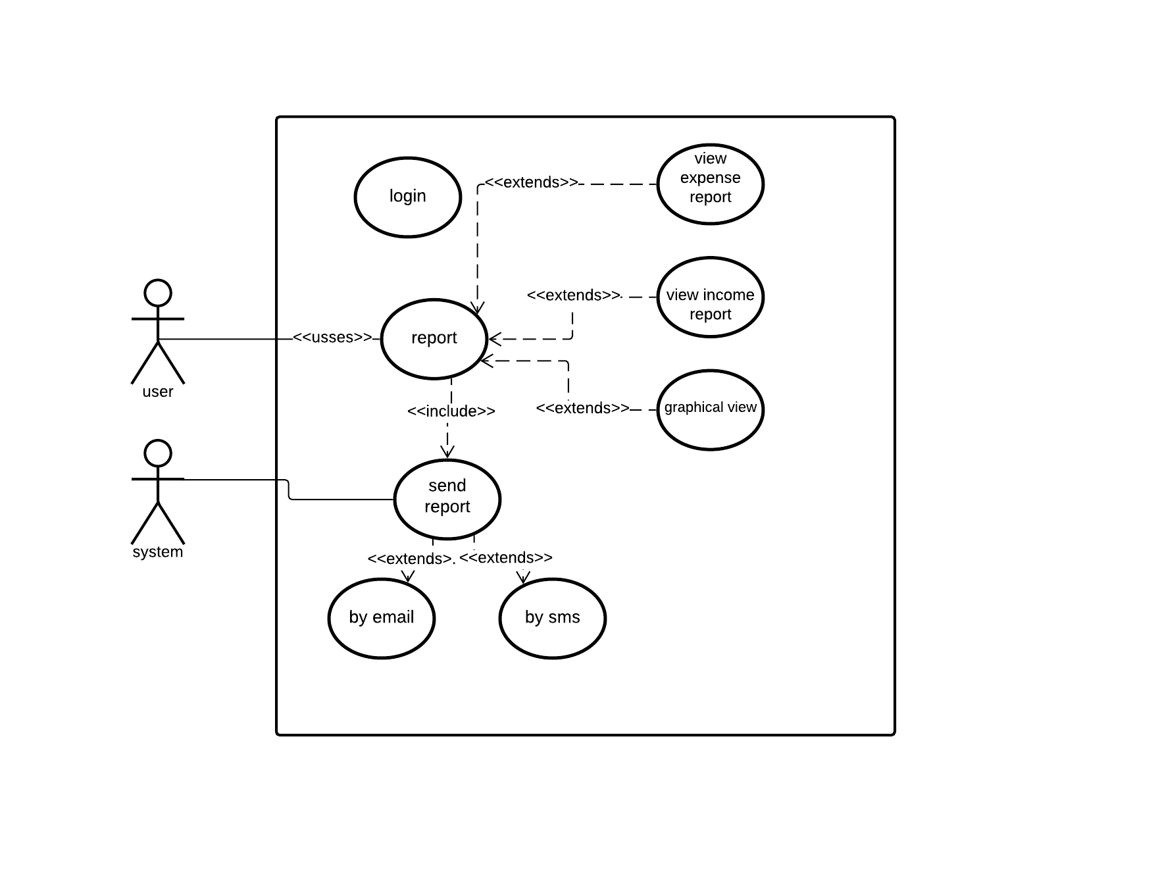
Use case diagram for provide report:

Slide 15
Use case narrative:
Name: provide report
Priority: High
Description: This is for view, create and delete the task.
Primary Actor: user
Precondition: User will have to login to the system.
Post-Condition: User views the list of expenses and detailed expense report of a particular item

